Slide 1
SimuVest

Slide 2
Essential Skills for Investing
Risk Assessment
Diverse Understanding
Patience
Judgement of Stability vs Growth
Persistence
Buy Low-Sell High

Slide 3
One product to build all essential skills in a new investor.
By simulating the creation of a custom stock fund, we inculcate hands-on-learning within a safe environment.
Solution

Slide 4
Proposed Solution
→A platform for youths to practise investing in the stock market without using their own money.
→ Challenge the user to make their own stock fund, which contains a variety of stocks and bonds and is based on their own analysis of the stock market.
→ Track the performance of your custom fund and pick up essential investing skills along the way.

Slide 5
Business Case
Problem(s):
Youths have lack of financial knowledge
Overwhelming amount of information
Youths feel uncomfortable with using their own money for something they have never done before.
Benefits:
Improves efficiency and convenience in investing
A fast way to equip youths with financial knowledge to start investing
A safe platform for youths to learn investing through simulation exercise

Slide 6
Solution Architecture

Slide 7
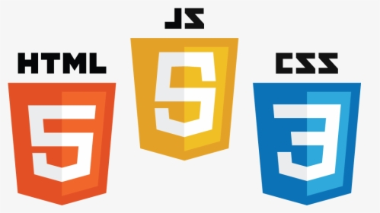











Users
Front-End
External services
Database
Servers
Backend Server
Amazon Cognito
Notes:
Icons made by <a href="https://www.flaticon.com/authors/freepik" title="Freepik">Freepik</a> from <a href="https://www.flaticon.com/" title="Flaticon"> www.flaticon.com</a>
Icons made by <a href="https://www.flaticon.com/authors/dinosoftlabs" title="DinosoftLabs">DinosoftLabs</a> from <a href="https://www.flaticon.com/" title="Flaticon"> www.flaticon.com</a>
Icons made by <a href="https://www.flaticon.com/authors/freepik" title="Freepik">Freepik</a> from <a href="https://www.flaticon.com/" title="Flaticon"> www.flaticon.com</a>

Slide 8
Technology used
Information Technology- Web
Cloud Computing

Slide 9
Product Demo

Slide 10
Future Work
Incorporate Singapore’s stock market details into our database
Incorporate a stock market analyst in the form of a chatbot

